Slide 1
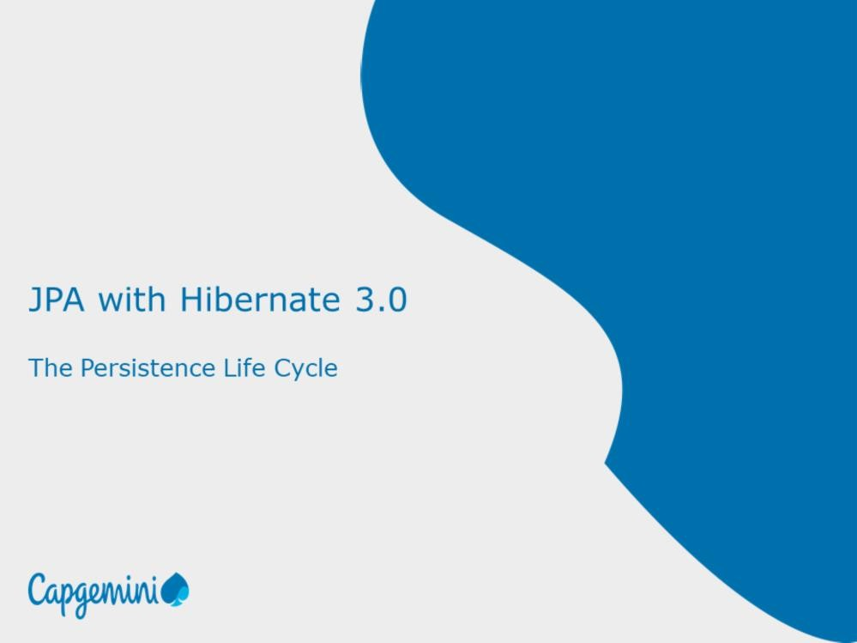
JPA with Hibernate 3.0
The Persistence Life Cycle
Instructor Notes:

Slide 2
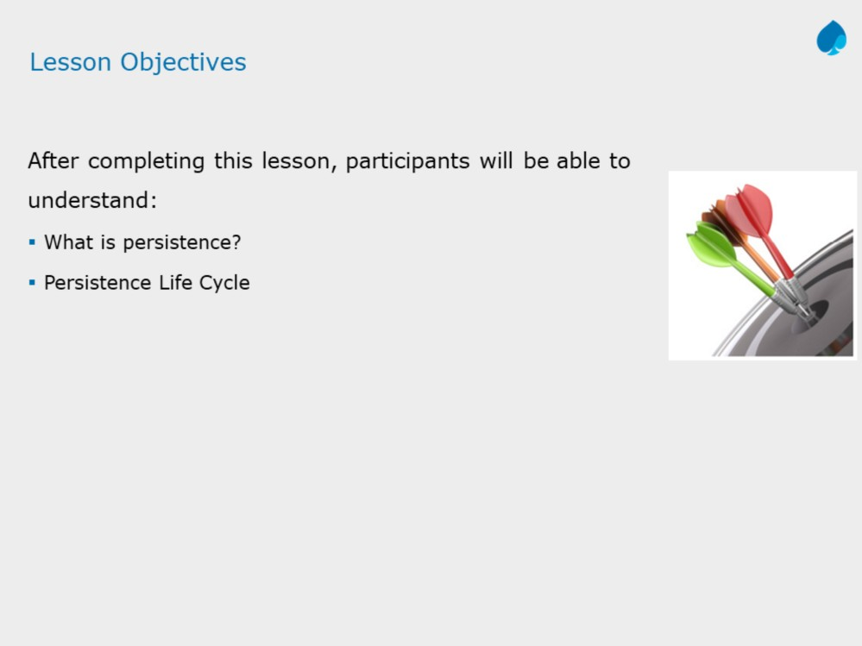
JPA with Hibernate 3.0
The Persistence Life Cycle
Instructor Notes:
Add instructor notes here.

Slide 3
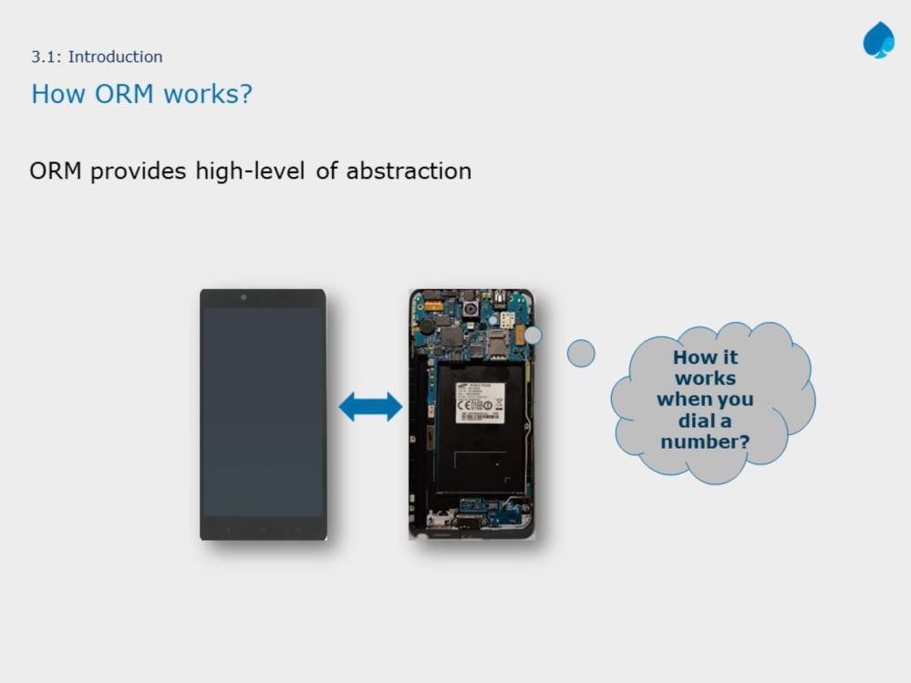

Slide 4
Before we start working with ORM, it is very important to understand how ORM works. The slide shows an example of abstraction, when we dial or receive a call on mobile, lot of functionality goes in background. We as a user, least bothered about internal component working due to abstraction.
Similarly, objects created in your application, when passed to ORM, get stored in database table. How it happens? What work goes in background? How your object persisted in database?
This lesson tries to answer abstract working of ORM and we will discuss in
details about the object’s persistence life cycle.

Slide 5
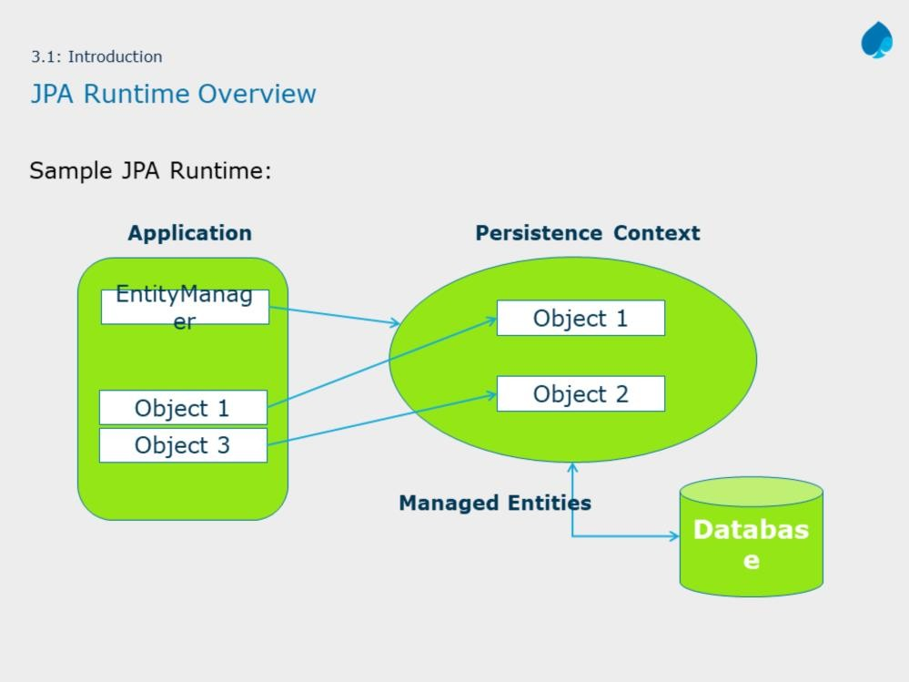
JPA with Hibernate 3.0
The Persistence Life Cycle
Instructor Notes:
The slide doesn’t cover entire JPA runtime. Before we discuss the persistence life cycle, we need to explain, which instance is responsible for entity life cycle. Where entities are cached? etc.

Slide 6
Entity Manager:
The EntityManager is the primary interface used by application developers to interact with the JPA runtime.
Persistence Context:
Persistence context defines a scope under which particular entity instances are created, persisted, and removed.
Every EntityManager manages its own persistence context. In short, persistence context is a memory area for EntityManager to work on entity instance.
The slide diagram shows a sample JPA runtime. JPA uses EntityManager instance to manage objects which required to be persisted. Such objects are called Entities. Entities managed by EntityManager travels through different life cycle phases. This lesson primarily focuses on entities persistence life cycle.

Slide 7
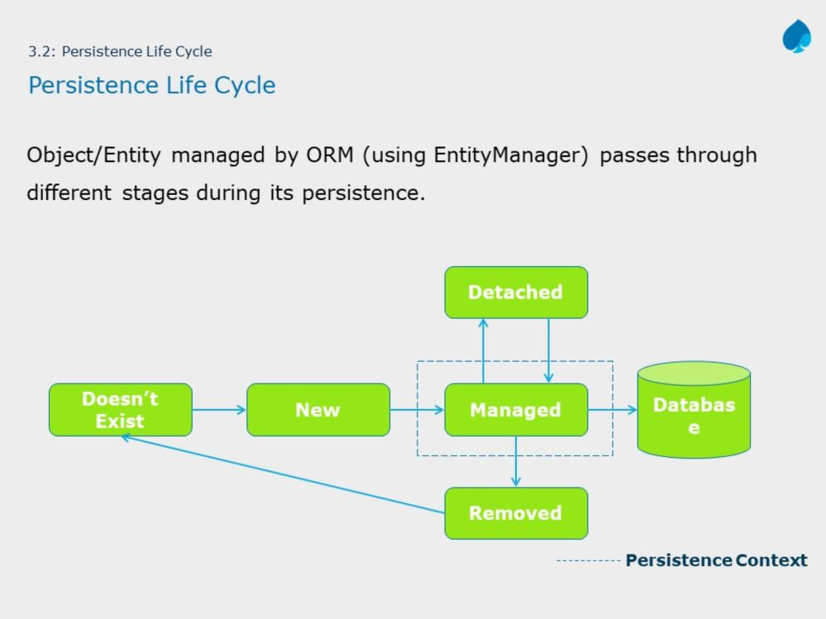
The slide diagram shows different states of entity. When entity is in managed state, the data of entity is persisted in database.
The remaining slides discusses about entity states in details.

Slide 8
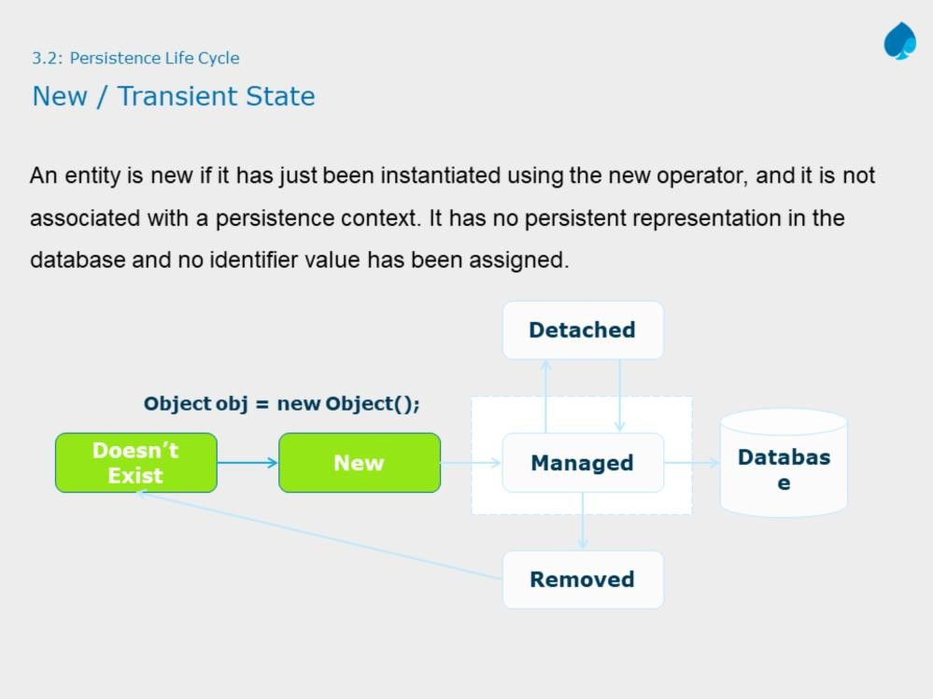
New State :When an entity object is initially created its state is New. In this state the object is not yet associated with an Entity Manager and has no representation in the database.

Slide 9
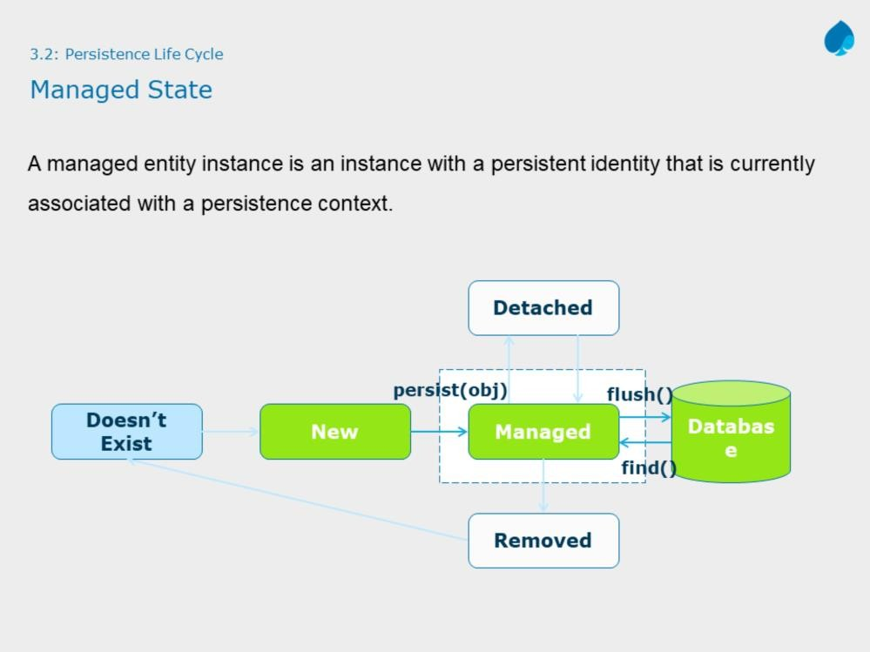

Slide 10
Managed State : An entity object becomes Managed when it is persisted to the database via an EntityManager’s persist method which must be invoked within an active transaction. On transaction commit, the owning Entity Manager stores the new entity object to the database.
Entity objects retrieved from the database by an EntityManager are also in the Managed state.
If a managed entity object is modified within an active transaction the change is detected by the owning EntityManager and the update is propagated to the database on transaction commit.
Note: The methods shown in slide are of EntityManager interface.

Slide 11
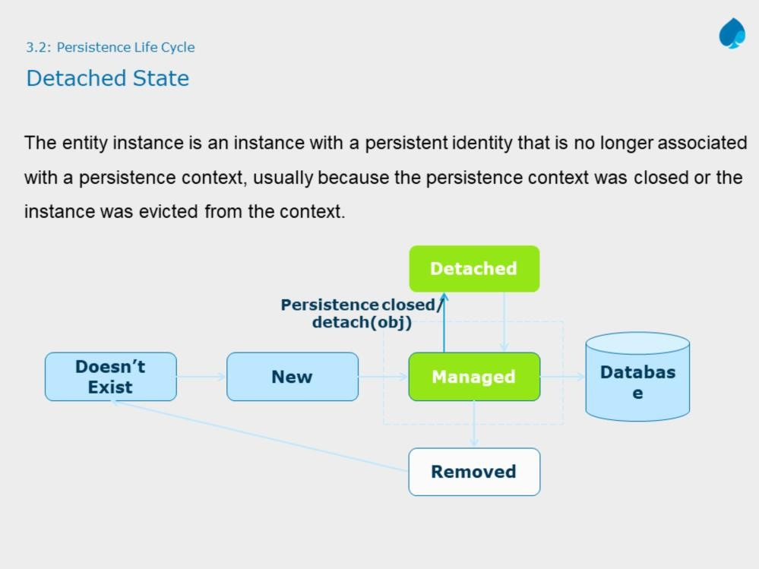
Detached State : represents entity objects that have been disconnected from the EntityManager. For instance, all the managed objects of an EntityManager become detached when the EntityManager is closed.
Note: The method shown in slide are of EntityManager interface.

Slide 12
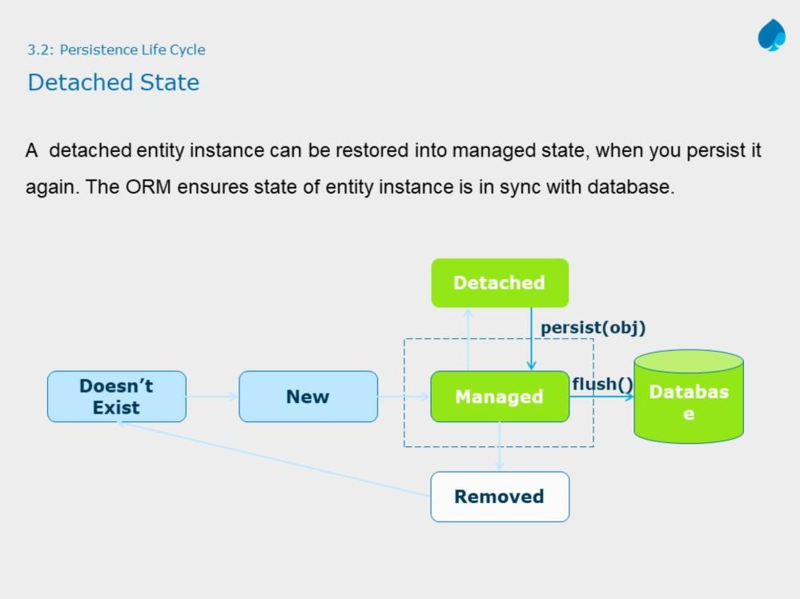

Slide 13
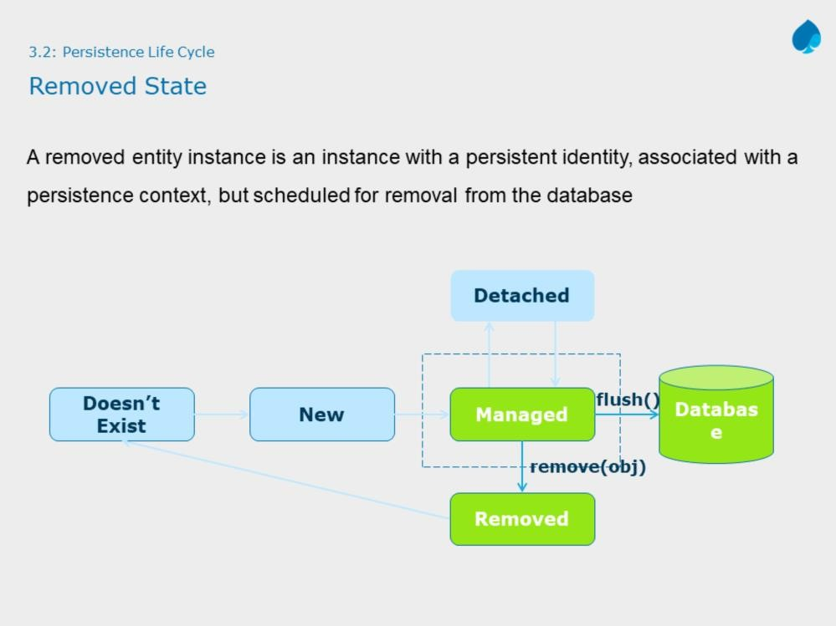

Slide 14
Removed State : A managed entity object can also be retrieved from the database and marked for deletion, by using the EntityManager’s remove method within an active transaction. The entity object changes its state from Managed to Removed, and is physically deleted from the database during commit.
Note: The methods shown in slide are of EntityManager interface.

Slide 15
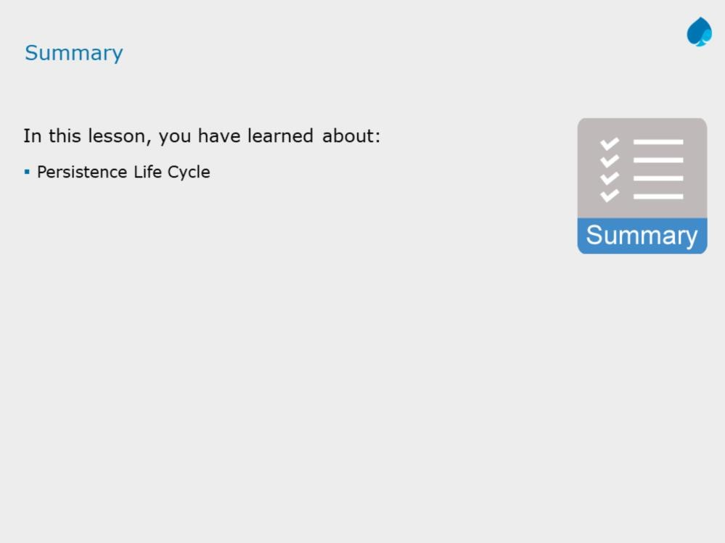

Slide 16
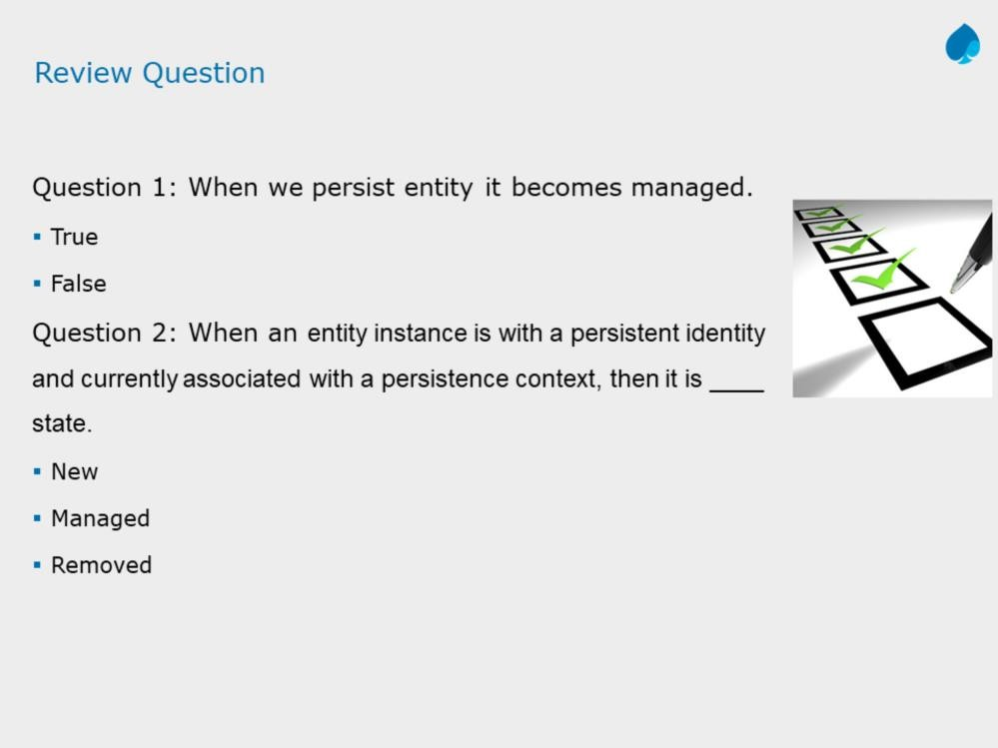
JPA with Hibernate 3.0
Instructor Notes:
Answers:
True
Managed

